Slide 1

RISK AND RESILIENCE BOOTCAMP
5

Slide 2


Slide 3
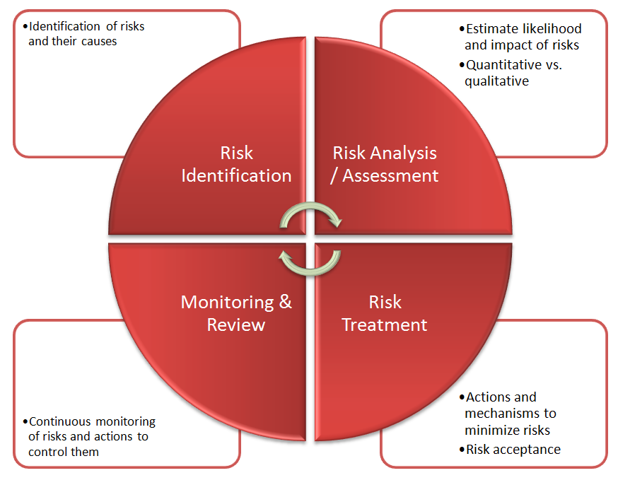
Risk Statements and Registers
In this module we will cover
Risk Statements
Risk Registers

Slide 4
Risk statements
Risk statements
  Translate observations and analysis into clear, actionable form
  Provide a common language between technical, business, and governance teams
  Essential for prioritization, mitigation, and executive decision-making
A strong risk statement answers the question
  “What could happen, why could it happen, and what would be the impact if it does?”
  This structure ensures that risks are complete, specific, and testable, supporting later steps in analysis and monitoring

Slide 5
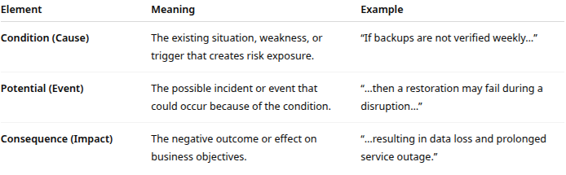
Structure of a Risk Statement
A standard risk statement includes three core elements
  Sometimes called the “CPC model”
    Eg. “If backups are not verified weekly (condition), then a restoration may fail during a disruption (potential), resulting in data loss and prolonged service outage (consequence).”

Slide 6
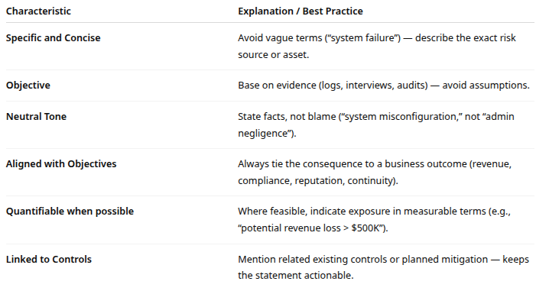
Effective Risk Statements

Slide 7
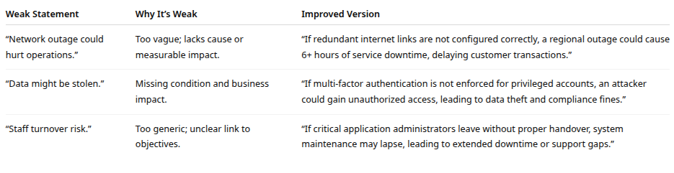
Common Mistakes

Slide 8
Integrating with Identification Process
Interviews
  Provide the conditions (e.g., weak process)
Logs and checklists
  Identify the potential events
Exploratory analysis
  Reveals the consequences and ripple effects
The completed statement forms the foundation for risk scoring, register entries, and mitigation plans

Slide 9
Risk Registers
The risk register
  Is the organization’s central, living repository for all identified risks, their analyses, mitigation plans, and monitoring status
  Ensures that nothing discovered during risk identification gets lost and that ownership, accountability, and follow-up are visible
Think of it as the “memory” and dashboard of risk management

Slide 10
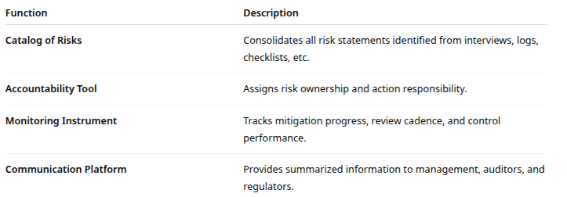
Core Functions

Slide 11
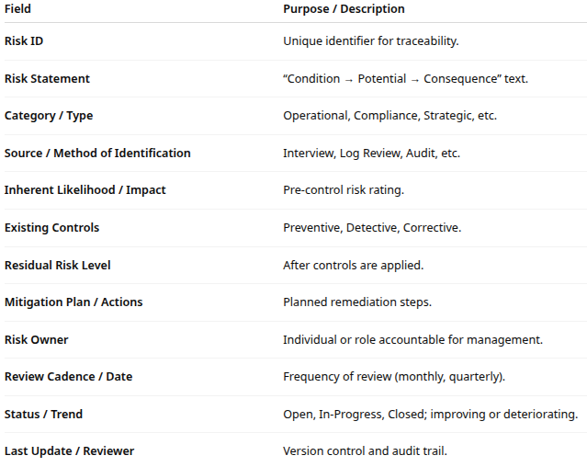
Typical Structure and Fields

Slide 12
“Living Document” Principle
A risk register is not static
  It must be continuously updated as the environment, controls, and risk appetite evolve
Examples of updates
  New risk identified from a security incident: added immediately
  Control implemented: residual risk level adjusted downward
  Business process decommissioned: related risk closed
  Regulatory change: new compliance risks introduced

Slide 13
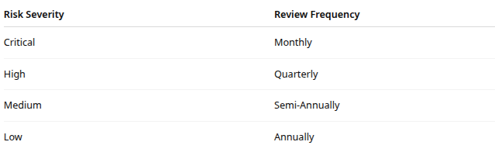
Review Cadence

Slide 14
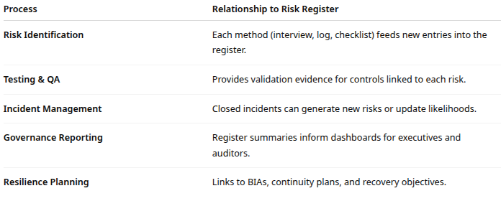
Integration with Other Processes

Slide 15
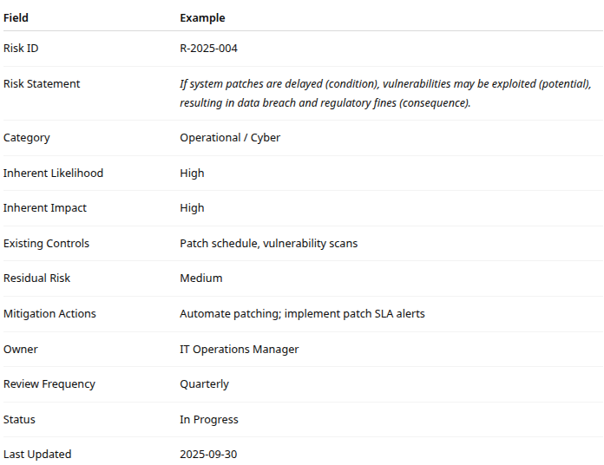
Simplified Risk Register Entry

Slide 16

Q&A and open discussion
Notes:
Now is the time to engage in an interactive Q&A session where you can ask questions, share insights, and clarify any doubts about the topics we have covered so far.
This open discussion is designed to ensure that every participant has the opportunity to voice their thoughts and learn from the collective experience of the group.
Your questions and comments are valuable as they help us identify areas that may need further explanation and enable us to tailor future sessions to your needs.
We encourage you to speak up and contribute to the dialogue, as this interaction is one of the key components of our interactive learning approach.
As the session progresses, take note of any questions or ideas that you would like to revisit, and feel free to share your perspectives with the class.

